Slide 1
GROUP DISCUSSION
WEEK-9
PAGES 1-29

Slide 2
GROUP DISCUSSION
Group discussion is a systematic & purposeful interactive oral practice.
A small group discussion follows democratic guidelines & allows everyone to contribute many ideas for others to discuss & reflect upon
The literal meaning of the group discussion is “to talk in detail”
Oral exchange of information, views & opinions about the topic, issue, problem or situation among members of a group who certain common objectives.
conversations allow people to share their ideas in order to create new understanding for everyone in the group.

Slide 3
MAIN PROCEDURAL STEPS IN USING GROUP DISCUSSION
The purpose of the small group discussion is to contribute & circulate information on the particular topic & analyze & evaluate the information for supported evidence in order to reach an agreement on general conclusions.

Slide 4
STEP-1 INTRODUCTION
The presenter must prepare before the discussion for it to be successful
The presenter should try to introduce a topic on which all of the participants have some background information regarding the topic.

Slide 5
Introduction should have four parts
Instructional objective
It should be given to the participants at the beginning of the discussion
Purpose:
The presenter should explain why the group will be discussing the chosen topic
Relationship:
The presenter must explain how this information fits in with what has already been learned or what will be learned in the future
Advanced Organizer:
An advanced organizer is some sort of attention- grabber that attracts participants’ interest.

Slide 6
Step-2 Directing the Discussion
The presenter is in charge of directing the discussion to get it started.
The presenter should ask the participants if they have questions about the topic at hand.
Another way to begin the discussion is to ask the participants to recall & share personal events that have happened in their lives that relate to the topic.
Questions are important in keeping the discussion moving.

Slide 7
STEP-3: SUMMARIZING THE DISCUSSION
The presenter or group leader should summarize to understand what has been discussed
In group discussion, it is essential that all participants agree on the same points
A final conclusion should be forwarded/ recorded or written clearly for all participants to avoid any ambiguity after the discussion
Summarizing will help to avoid any confusion later on.

Slide 8
Elements of a good discussion
it's important that you come to the conversation prepared.
Often the topic or issue of the conversation is given beforehand.
Familiarize yourself with as much background information that you can so that you'll have some reliable facts and information to contribute to the conversation.

Slide 9
Elements of a Good Discussion
When the group meets make sure that where and how you're sitting makes everyone feel comfortable and part of the group.
Everyone should be on the same level, should have eye contact with each other, and the desk should be cleared of any distractions.

Slide 10
Elements of a good discussion
Thirdly, know the purpose of the conversation and help the group achieve it. It's important that the group has a common goal so they can move toward it together.

Slide 11
Elements of a good discussion
listen to understand
Give yourself quiet time to think about the information that's been said and ask follow up questions if you don't understand.

Slide 12
Elements of a good discussion
Communicate clearly, try to have your ideas organized in your mind before you share them with the group.
Give relevant and specific examples that illustrate the point you want to make.

Slide 13
Elements of a good discussion
think deeply.
be dynamic with your voice and gestures to bring positive energy to the group. Use your voice to emphasize important ideas by saying them louder and longer.
Use your eyes, hands, arms, and your smile to make gestures that keep the group members engaged with what you have to say.

Slide 14
Elements of a good discussion
be humble, positive, and respectful.
Truly believe that everyone you will ever meet knows something that you don’t, and act accordingly.
Avoid being the person who has all the answers and tells others where they’re wrong, instead be someone who’s open-minded and admits there’s a lot that can be learned.
Respect others by not interrupting and by responding positively and relevantly to their ideas.

Slide 15
Problems in Group Discussions
Getting off track
uneven participation
a bad attitude
(Read page no 2 & 3)

Slide 16
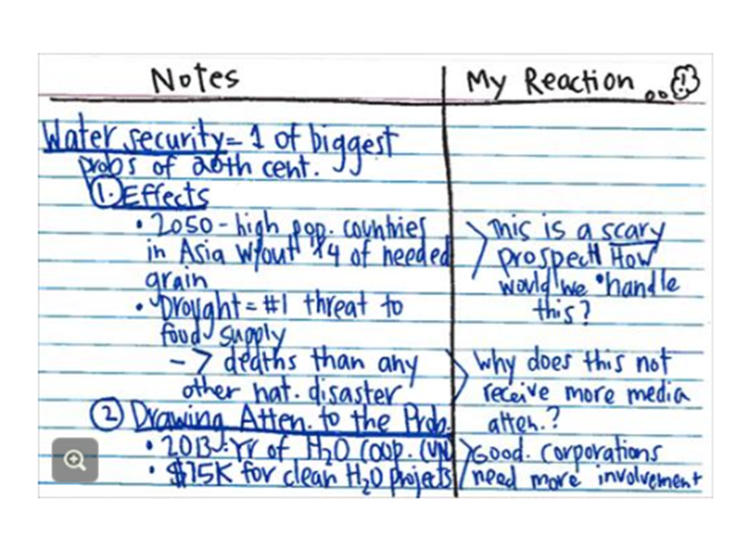
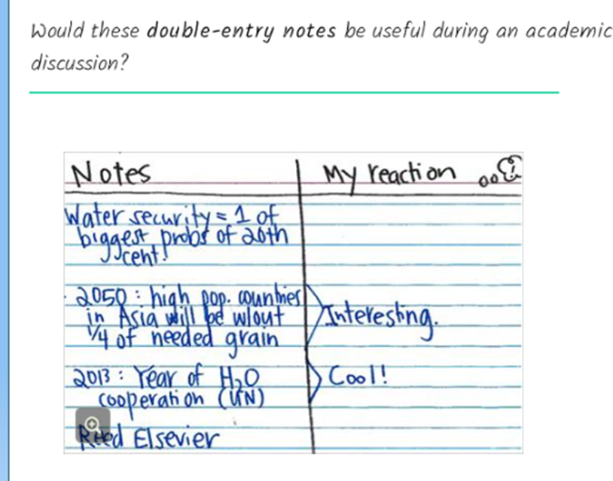
Following are two examples of two students’ discussion preparation reading. Which is better and why? The both read material on “Water Crisis” for group discussion.

Slide 17
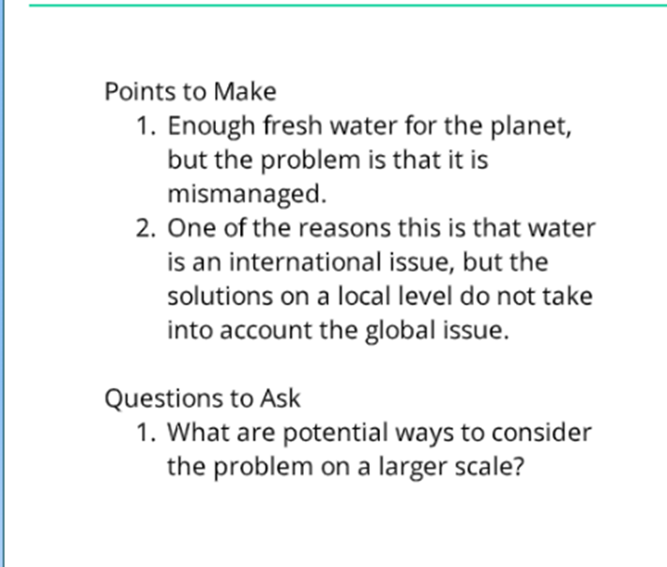
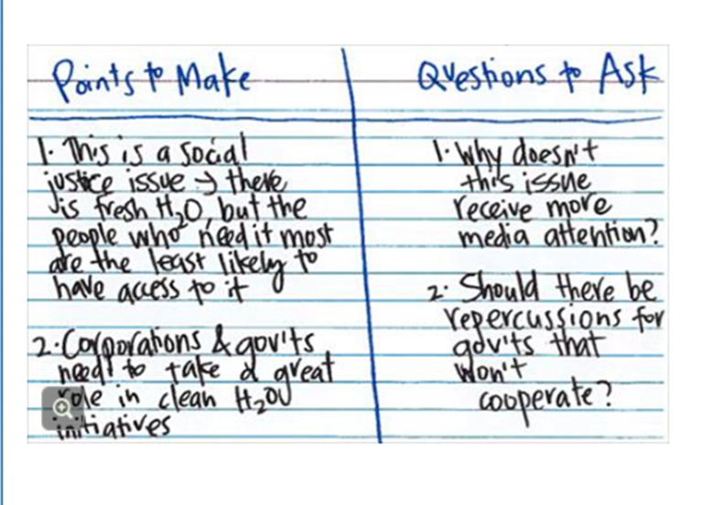
Comment on the usefulness of the following for the group discussion.

Slide 18
Make outline for discussion preparation keeping in view last two slides.
Topic of discussion is
Is it better to study online or in regular classroom?

Slide 19
VARIATION OF SMALL-GROUP DISCUSSION (Pg. 24-25)
Cooperative Learning Group
Problem Solving Group
Group Investigation

Slide 20
Cooperative Learning Group
In cooperative learning , a small group of participants works together to achieve common goal
Participants achieve more in cooperative learning
The goal of cooperative learning are positive, interdependence, face to face interaction among the participants.
Small group discussion allow the participants to get to know each other on the personal level

Slide 21
Problem Solving Group
These kind of group discussions exist to cooperate, discover, inquire & think critically
For example: several participants might work together to solve mathematical problems through exploration
The purpose of problem solving groups is to approach real-life problems with an appropriate strategy
Problem-solving groups help participants come to logical solutions & make responsible decisions.

Slide 22
Group Investigation
The group divided into small groups based on particular interests
Each group has certain category, they gather information and analyze it for meaning
The participants prepare and then deliver presentation to about their discovery or conclusion.

Slide 23
Preparing the Discussion ( pg. no 3)
Reading
key vocabulary from the text
a short list of things you'd like to say or ask about the topic
make a list of questions you'd like to ask about things you don't know or would like to hear other people discuss.
Questions show that you're trying to learn from others and that you're open to new possibilities.

Slide 24
How to Start the Discussion Conversation?
first step is to get settled into a position where all participants are able to see each other. You may have to move chairs and desks to reposition yourselves. A circle formation is ideal, that way everyone can see each other. Avoid negative body language such as crossed arms. Try to be aware of your body language.
The next step is to introduce yourself.
It's very important to address the question. A really common problem in discussions is going off topic or not hitting the target. It's really important that all group members agree on what should be discussed.

Slide 25
To sum up, make sure you have a good arrangement so everyone can see each other and participate equally. Then introduce yourself to establish a friendly environment, and so you can use each other's name during discussion.
And finally, make sure everyone understands the discussion topic so that your conversation achieves its goal. Now you're ready to start your conversation.

Slide 26
Constructing Conversation in Discussions
background knowledge
By acknowledging comments made by your group members, you strengthen the spirit of the group as you show that their comments count and that they're being heard
building on the comments of others usually requires critical thinking, which as we've discussed previously, adds depth to any discussion.
Lastly, building on the comments of others simply moves an idea further.
Build a firm foundation. Be clear about the task your group needs to accomplish. And build on the comments and ideas of others.

Slide 27
Elaboration in Discussion
Elaborate means to add more.
In a discussion, you bring your ideas and opinions to the table. You want your contributions to be generous. The way to be generous in a conversation is to elaborate, or add more to you your answers.
In a conversation you have two jobs when it comes to elaboration.
The first job is to elaborate on your own responses. You need to support and
2nd is to explain your ideas through support material

Slide 28
Critical Thinking in Discussions
Read pg. 11 & 12

Slide 29
A psychologist named Benjamin Bloom categorized thinking into six levels. ( Read pg. 12)
Knowledge
Comprehension
Application
Analysis
Synthesis
Evaluation.
These are called Bloom’s Taxonomy

Slide 30
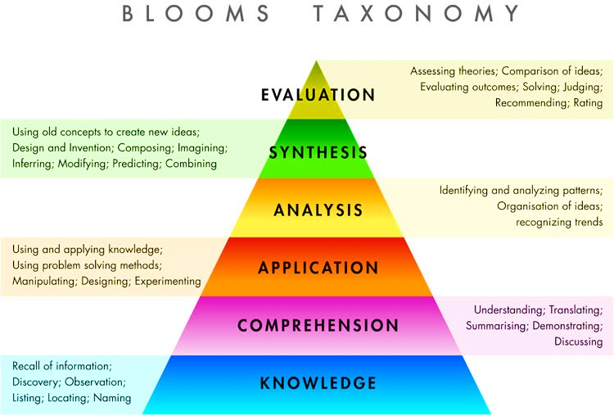

Slide 31
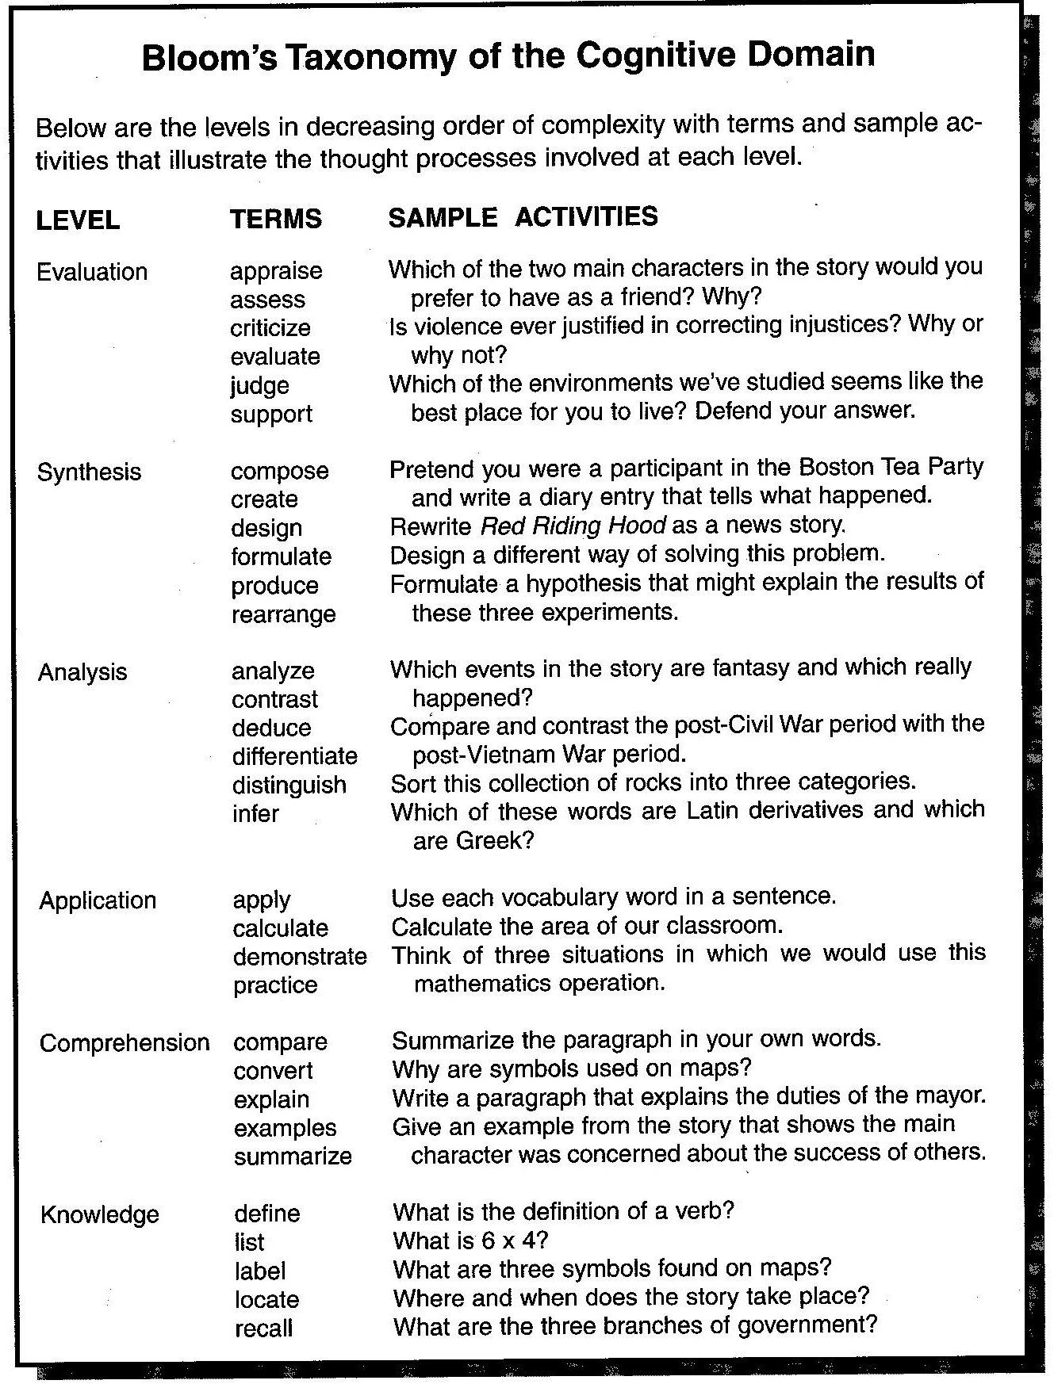

Slide 32


Slide 33
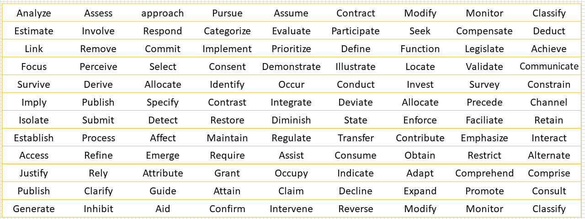
Language for Group Discussions
One type of academic vocabulary that's risk studying is the New Academic Word List.

Slide 34
Multi-word Expression.
A multi-word expression is two or more words that are strung together to have a single meaning, or single function. Take for example, the expression, high expectations, lower cost, high value.
A second type of multi-word expression is the sentence frame. Sentence frames are groups of words that have a single function such as agreeing or disagreeing with someone or paraphrasing what a group member has said or requesting evidence.
A third type of academic vocabulary is the vocabulary that's specific to your field of study.

Slide 35
Agreeing and Disagreeing
When you're having an academic discussion it's like you're building a house together. You're all working together to create a communal space in which you can discuss ideas and achieve common goals. In academics we call this space a discourse community.
There's bound to be disagreement in this process. When you're building a house, you might not agree on the color of the paint. But in a discourse community, disagreements will be over ideas. Disagreement is an essential and healthy part of the discussion process, because hearing a diversity of opinions is good for helping us develop and clarify our own ideas.

Slide 36
you're creating goodwill and opportunities for future consensus. So let's revisit our main points. When you're in a discussion and you want to disagree, be sure to check your body, voice, and the content of what you say, your words.
When this happens you and your conversation partners just have to agree to disagree and get on with the discussion. Just keep the tone of the conversation collaborative, not confrontational.

Slide 37
Synthesis in Group Discussions
a synthesis is a pulling together of elements to create something new.
You gather together information beforehand, from various sources, such as class lecture, reading or online data, and form your own ideas about the topic.
Then you bring that whole mix of information to your conversation. As you share your data and your own ideas, you synthesize.

Slide 38
Difference between Synthesis & Summary
A summary is a brief version of a longer text, it includes main ideas that are restated.
A synthesis is more involved. It involves pulling together information from different sources to support one's own ideas, and in the end create something new.
Summary and synthesis naturally happen in an academic discussion, but you want to make sure that your conversation isn't all summary.

Slide 39
Advantages of Group Discussion
All participants can participate.
Participants can easily understand each others’ opinion and point of view about the particular topic
Participant can identify another participant who needs help.
It helps participants to see relationships among ideas or concept related to the topic at hand

Slide 40
DISADVATAGES OF SMALL GROUP DISCUSSION
It is time consuming
Some participants can dominate the other introvert participants
The discussion can easily get off track

Slide 41
Limitation of Small Group Discussion
It is not the method that transmit information & facts
It involves more talk and less action
The discussion must be carefully planned, not impulsive (to conduct without plan) , to be effective

